Slide 1
WEEK 1
Internship under dr gs javed sir
INTERN NAME - AFZAL MALIK
College/UNIVERSITY – ZAKIR HUSAIN COLLEGE OF ENGG. & TECH.
ALIGARH MUSLIM UNIVERSITY
COURSE- BACHELOR OF TECHNOLOGY (ELECTRONICS ENGG.)
YEAR – SECOND

Slide 2
WEEK 1 INTERNSHIP PLAN
To be able to perform .dc /.op / .tran Simulations
To design Common Source and Common Drain Amplifier ( Used Gm over Id Method )
SOFTWARE USED : LT Spice , MS Excel

Slide 3
BASIC CIRCUIT SIMULATIONS
.Dc , .op and .tran Simulation of basic circuits using lt spice

Slide 4
DESIGN OF COMMON SOURCE AMPLIFIER ( USING GM OVER ID METHOD )

Slide 5
PARAMETER CHARTS
IN ORDER TO DESIGN AN AMPLIFIER USING GM OVER ID METHODOLOGY WE REQUIRE PARAMETER CHARTS :
a) Primary Charts
Gm/Gds vs Gm/Id
Id/W vs Gm/Id
Ft vs Gm/Id
b) Secondary Charts
1)Cgd/Cgg vs Gm/Id
2)Cdd/Cgg vs Gm/Id

Slide 6
Plotting Parameter Charts
Using lt spice and ms excel
Model file : 180n

Slide 7
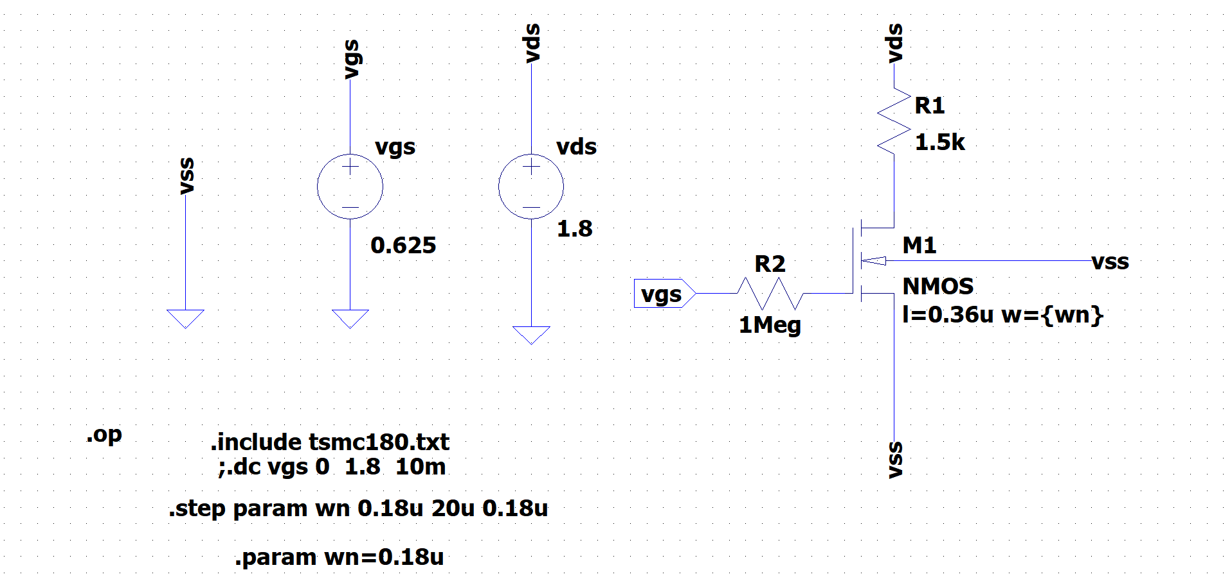
LT SPICE SETUP TO PLOT CHARTS FOR NMOS

Slide 8
AFTER MAKING THE SETUP IN LT SPICE
Id vs Vgs is plotted by sweeping vgs from 0 to 1.8 V
Gm [ d(Id(M1)] vs Vgs is plotted by sweeping vgs from 0 to 1.8 V
Id vs Vds is plotted by sweeping vds from 0 to 1.8 V
Gds [ d(Id(M1)] vs Vds is plotted by sweeping vgs from 0 to 1.8 V
All this data is transferred in MS Excel and then
Gm/Gds vs Gm/Id is plotted
Id/W vs Gm/Id is plotted
Hence , we got two of the parameter charts that are required to design Common Source Amplifier

Slide 11
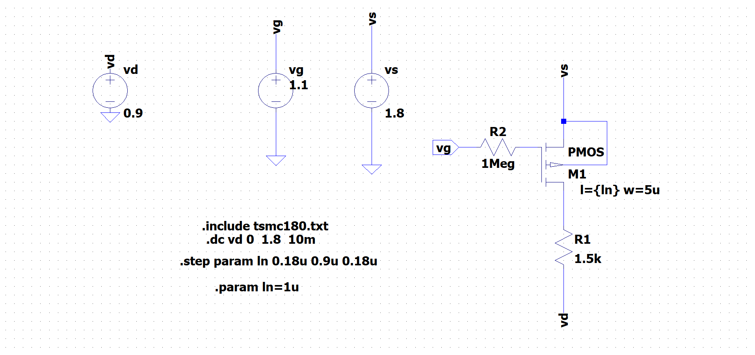
LT SPICE SETUP TO PLOT CHARTS FOR PMOS

Slide 14
COMMON SOURCE AMPLIFIER
Using NMOS AND PASSIVE LOAD
Model file : 180n
SPECIFICATIONS
GBW=800MHz , VDD=1.8V , L=0.36u

Slide 15

CALCULATIONS
GBW=800MHz , L=0.36u , Vdd=1.8V, Model file = 180n
Let GAIN (A) = 10
f(-3db) = $\frac{\text{G}BW}{\text{G}ain}$ = 80MHz let C_{L}=5pF
USING f(-3db) = $\frac{1}{2π Rout \text{C}\text{L}}$ Rout = 397.88 ohm
Now , Gain (A) = Gm Rout Gm=25.1 mS
Now , Let Gm/Id = 10.2 Id = 2.46 mA
(From NMOS Parameter Charts)
Gm/Gds = 69.9 Gds=359 uS
AS Ro=1/Gds , Ro=2785 ohm
(From NMOS Parameter Charts)
Id/W= 13.6 W=180u

Slide 16

CALCULATIONS
Now Rout = Ro || R_{L} R_{L} = $\frac{\text{Ro}\text{∗}\text{Rout}}{\text{(}\text{Ro}\text{ – }\text{Rout}\text{)}}$
R_{L} = 464.197 ohms
Now, Vgs is calculated from Gm/Id vs Vgs Curve in LT Spice
For , Gm/Id = 10.2
Vgs = 702mV = 0.702V

Slide 17
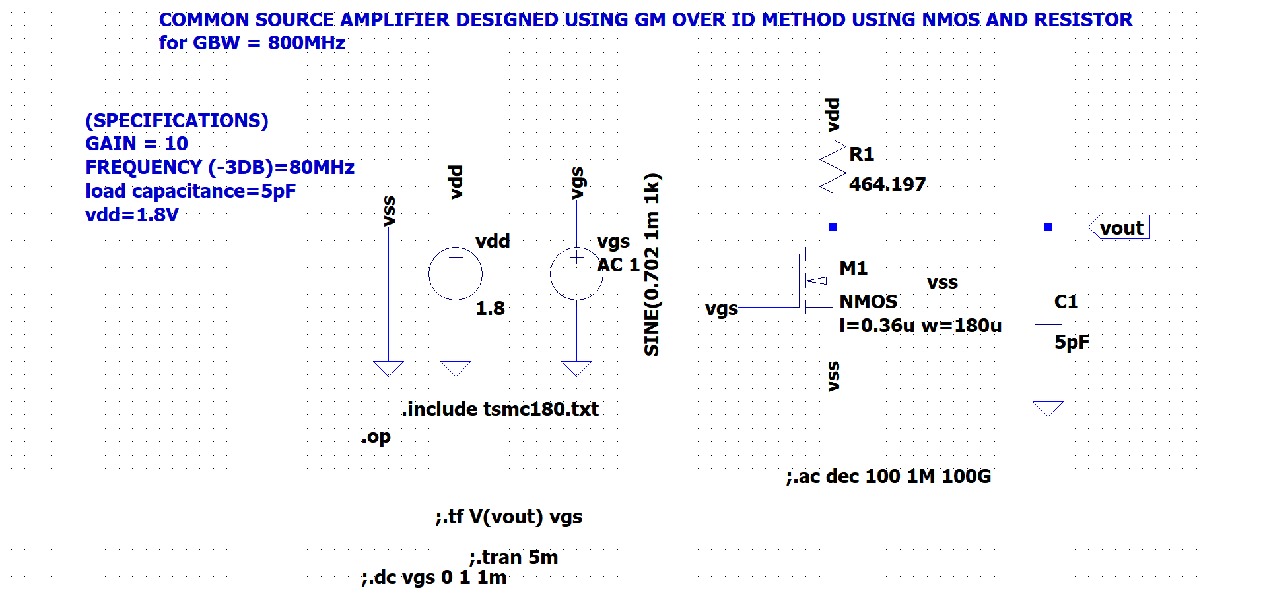
SCHEMATIC IN LT SPICE

Slide 18
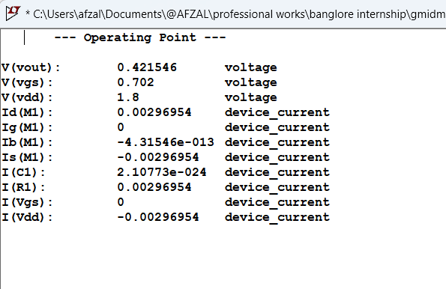
.OP ANALYSIS IN LT SPICE

Slide 19
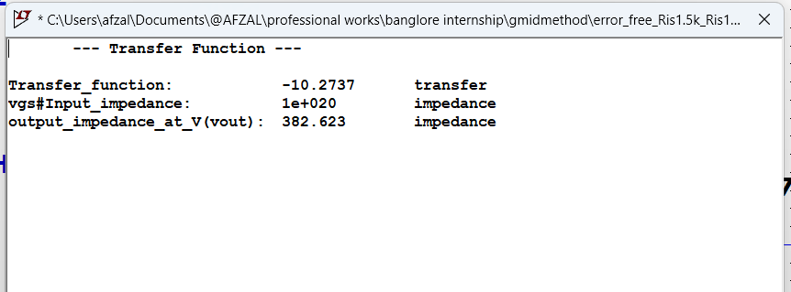

Slide 20
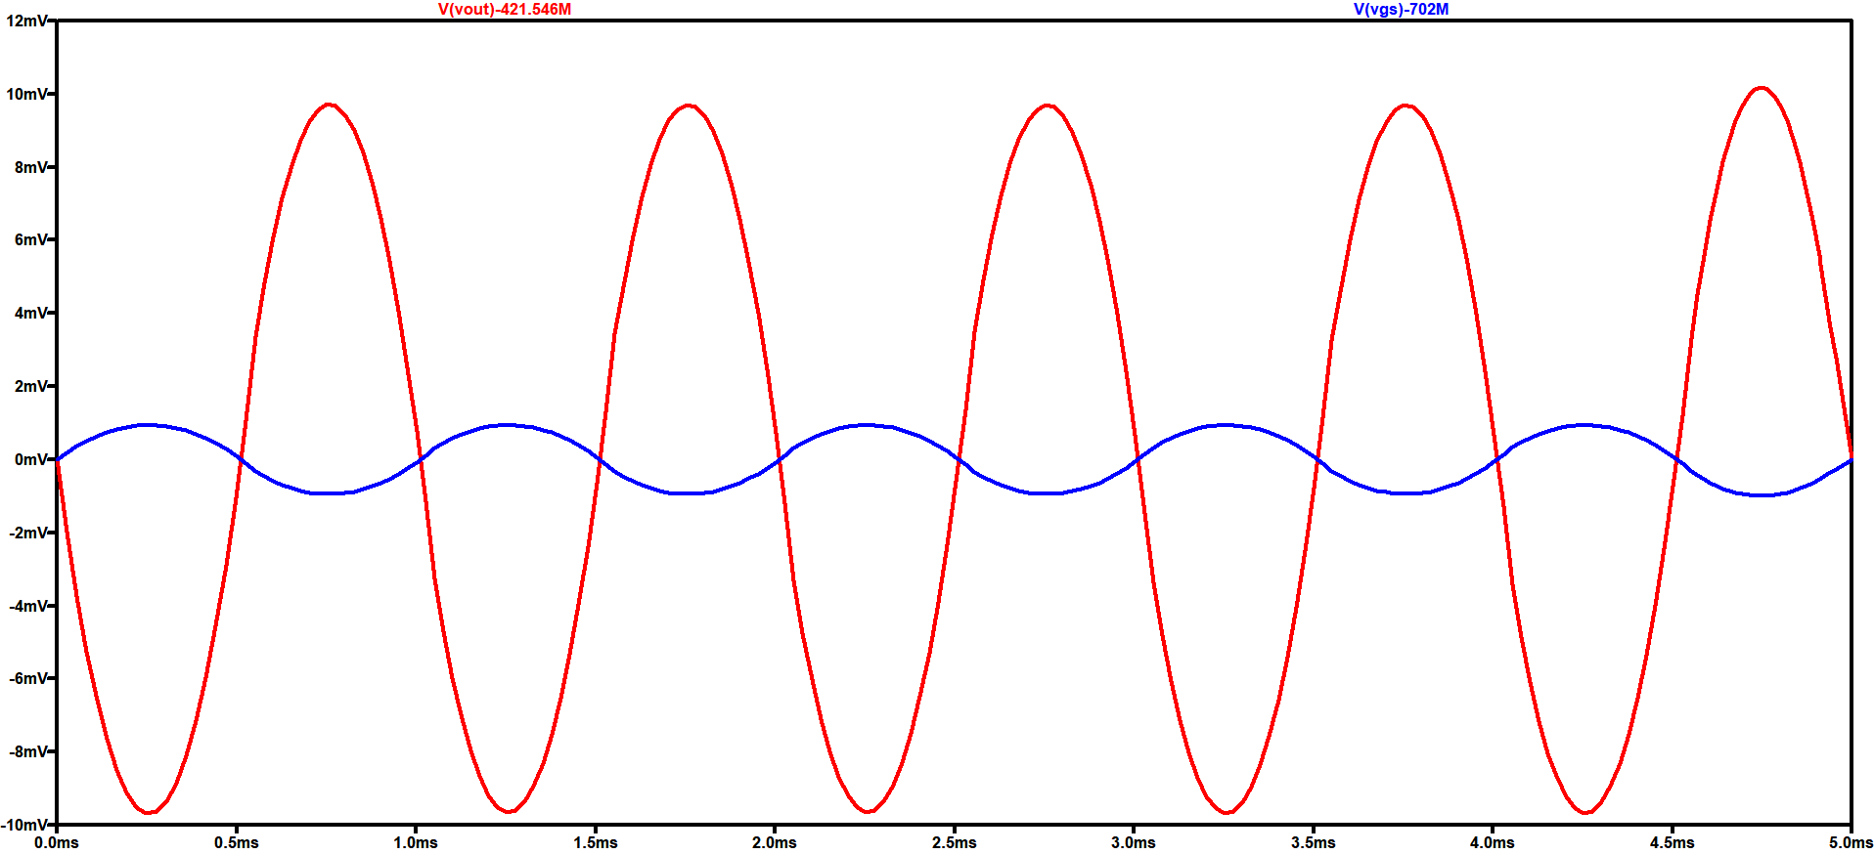
TRANSIENT ANALYSIS IN LT SPICE

Slide 21
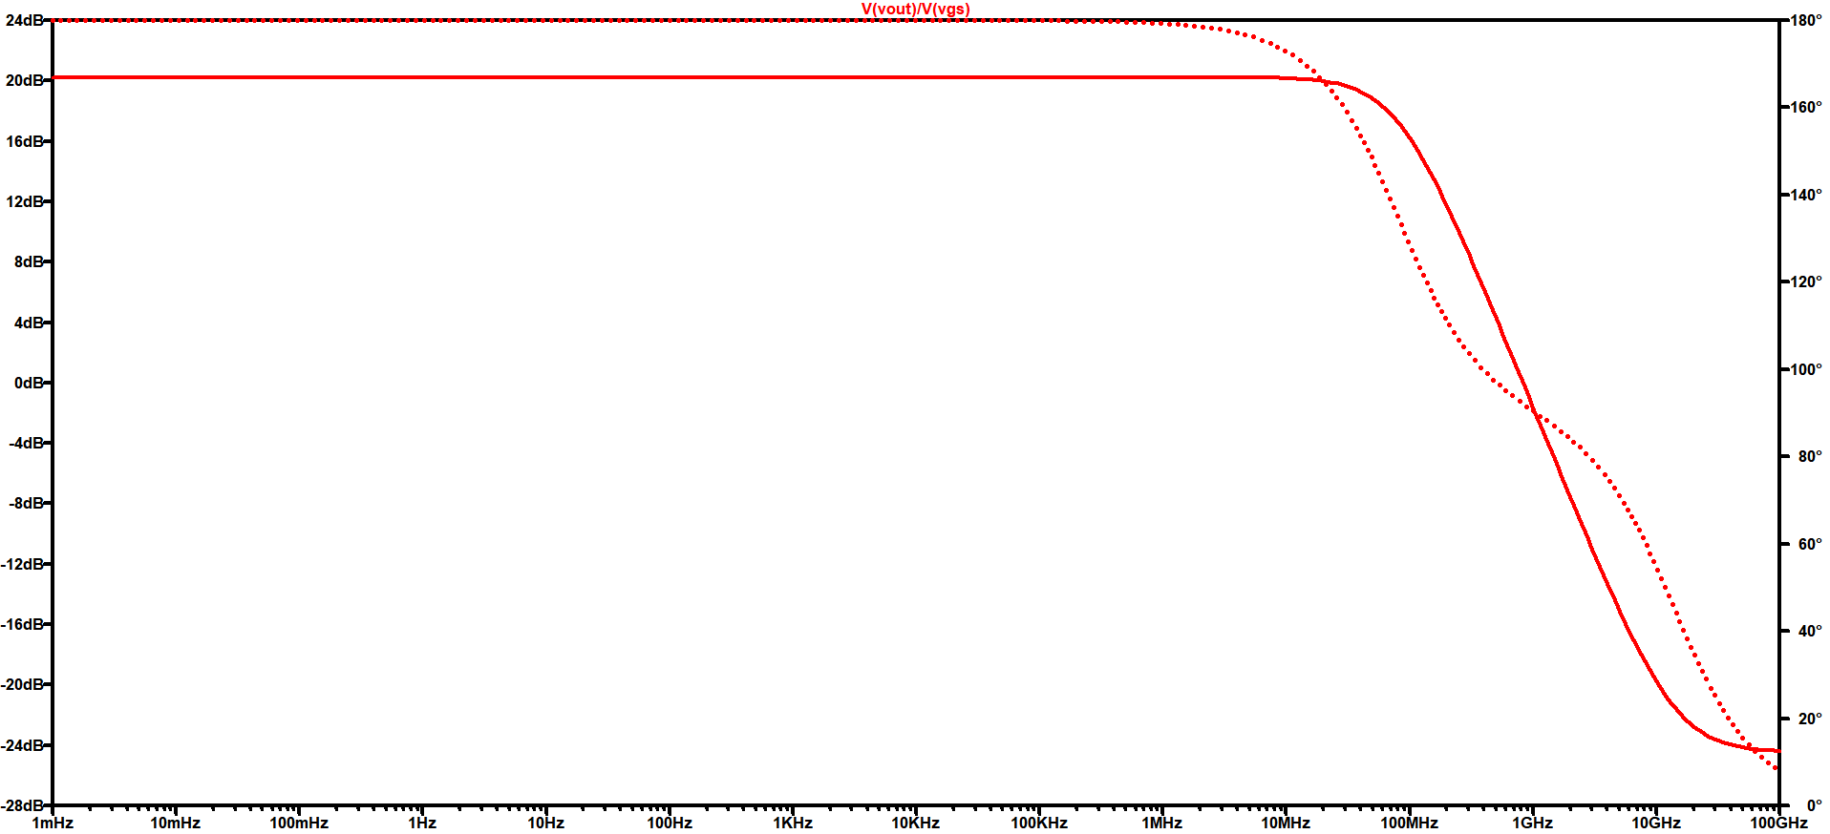
FREQUENCY RESPONSE IN LT SPICE

Slide 22
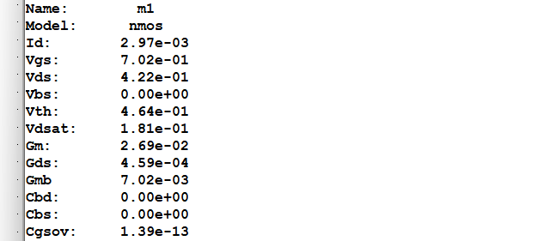
SIMULATIONS RESULT
GBW=837MHz
Gain= 10.2737

Slide 23
COMMON SOURCE AMPLIFIER
Using PMOS AND PASSIVE LOAD
Model file : 180n
SPECIFICATIONS
GBW=800MHz , VDD=1.8V , L=0.36u

Slide 24

CALCULATIONS
GBW=800MHz , L=0.36u , Vs=1.8V, Model file = 180n
Let GAIN (A) = 10
f(-3db) = $\frac{\text{G}BW}{\text{G}ain}$= 80MHz let C_{L}=5pF
USING f(-3db) = $\frac{1}{2π Rout \text{C}\text{L}}$ Rout = 397.88 ohm
Now , GAIN (A) = Gm Rout Gm=25.1 mS
Now , Let Gm/Id = 10.2 Id = 2.46 mA
(From NMOS Parameter Charts)
Gm/Gds = 72.2 Gds=347.64 uS
AS Ro=1/Gds , Ro=2876.5 ohm
(From NMOS Parameter Charts)
Id/W= 3.3 W=745u

Slide 25

CALCULATIONS
Now Rout = Ro || R_{L} R_{L} = $\frac{\text{Ro}\text{∗}\text{Rout}}{\text{(}\text{Ro}\text{ – }\text{Rout}\text{)}}$
R_{L} = 461.75 ohms
Now, Vgs is calculated from Gm/Id vs Vgs Curve in LT Spice
For , Gm/Id = 10.2
Vg = 1.1V

Slide 26
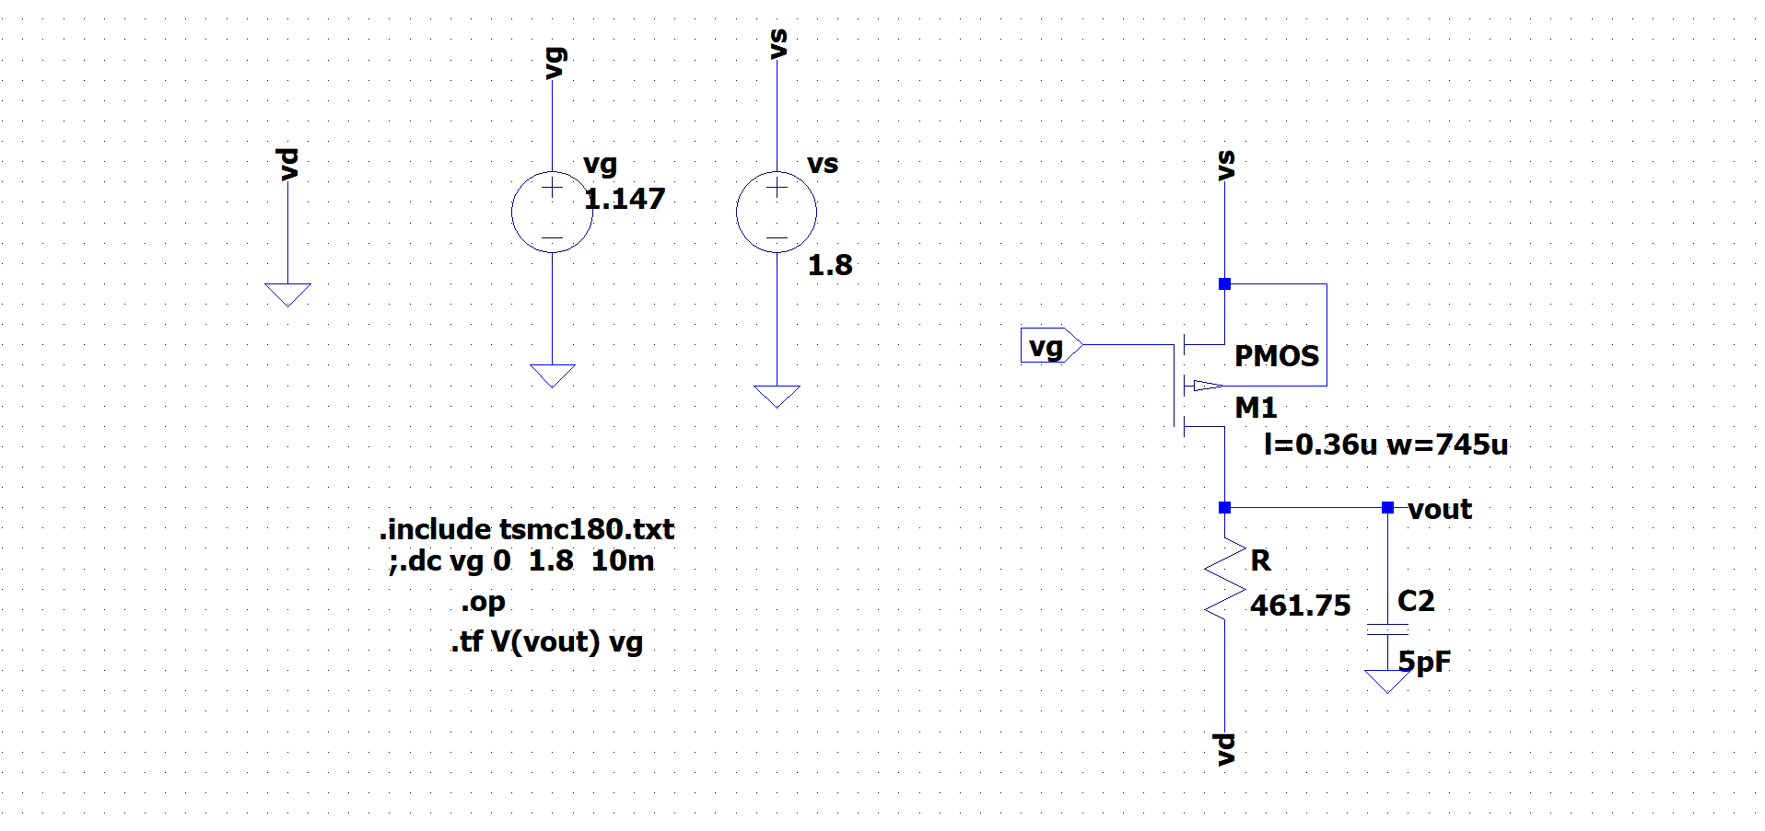
SCHEMATIC IN LT SPICE

Slide 27
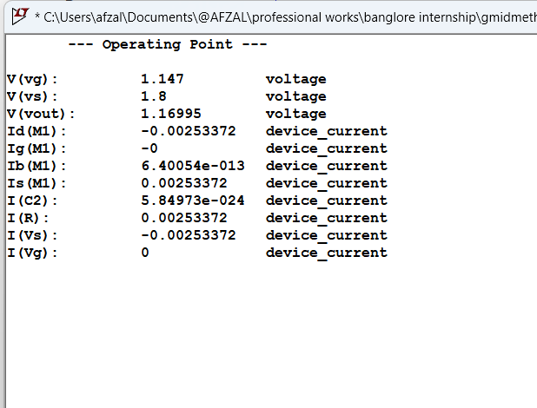

Slide 28
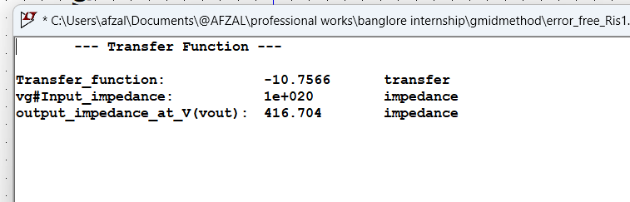

Slide 29
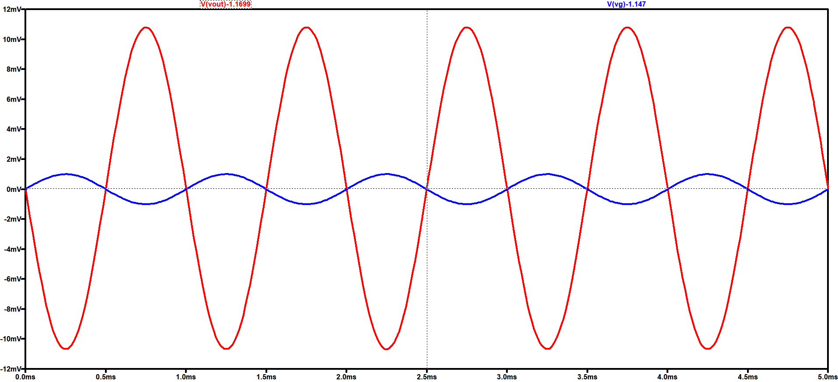
TRANSIENT ANALYSIS IN LT SPICE

Slide 30
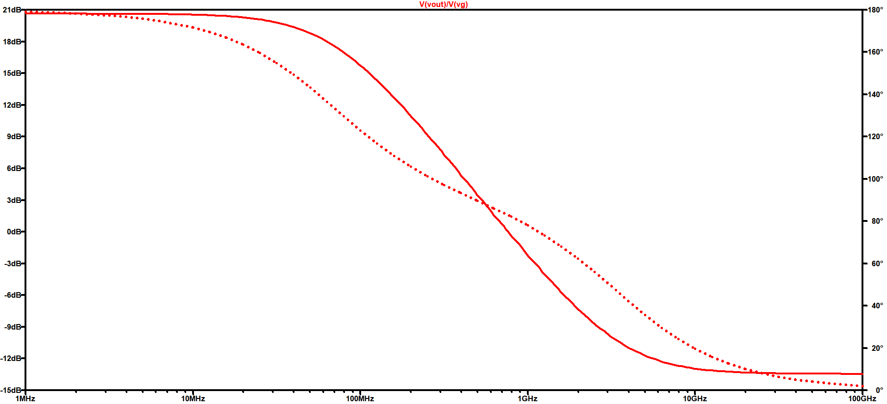
FREQUENCY RESPONSE IN LT SPICE

Slide 31
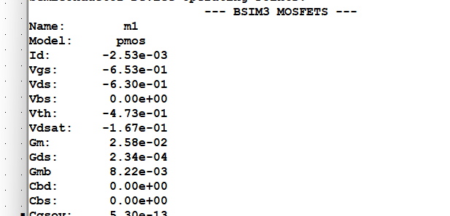
SIMULATIONS RESULT
GBW=763MHz
Gain= 10.756

Slide 32
COMMON DRAIN AMPLIFIER (SOURCE FOLLOWER)
Using NMOS AND RESITANCE
Model file : 180n
SPECIFICATIONS
VDD=1.8V , L=0.36u , GAIN(A)=0.95
Rout=50 ohm, C_{L} = 5pf

Slide 33

CALCULATIONS
VDD=1.8V , L=0.36u , GAIN(A)=0.95
Rout=50 ohm, C_{L} = 5pf
Using B.W = $\frac{1}{\text{2}π Rout \text{C}\text{L} }$ BW= 636.61MHz
Now , Gain (A) = $\frac{(Rs||Ro)}{(Rs|\left|Ro\right)+1/Gm}$ and Rout = 1/Gm||Ro||Rs
On solving both the equation , we get
Gm=19mS $(Rs||Ro)$=1000 ohm
Now , let Gm/Id = 15.1 Id=1.26mA
Gm/Gds = 38.2 Gds=497uS Ro=2.012 K ohm
And hence , Rs=1.988 K ohm ( by further inspection taken as 720 ohm )
Vgs = 0.543V Vg = vgs + vs =1.443 V
Id/W=5.65 W=223u

Slide 34
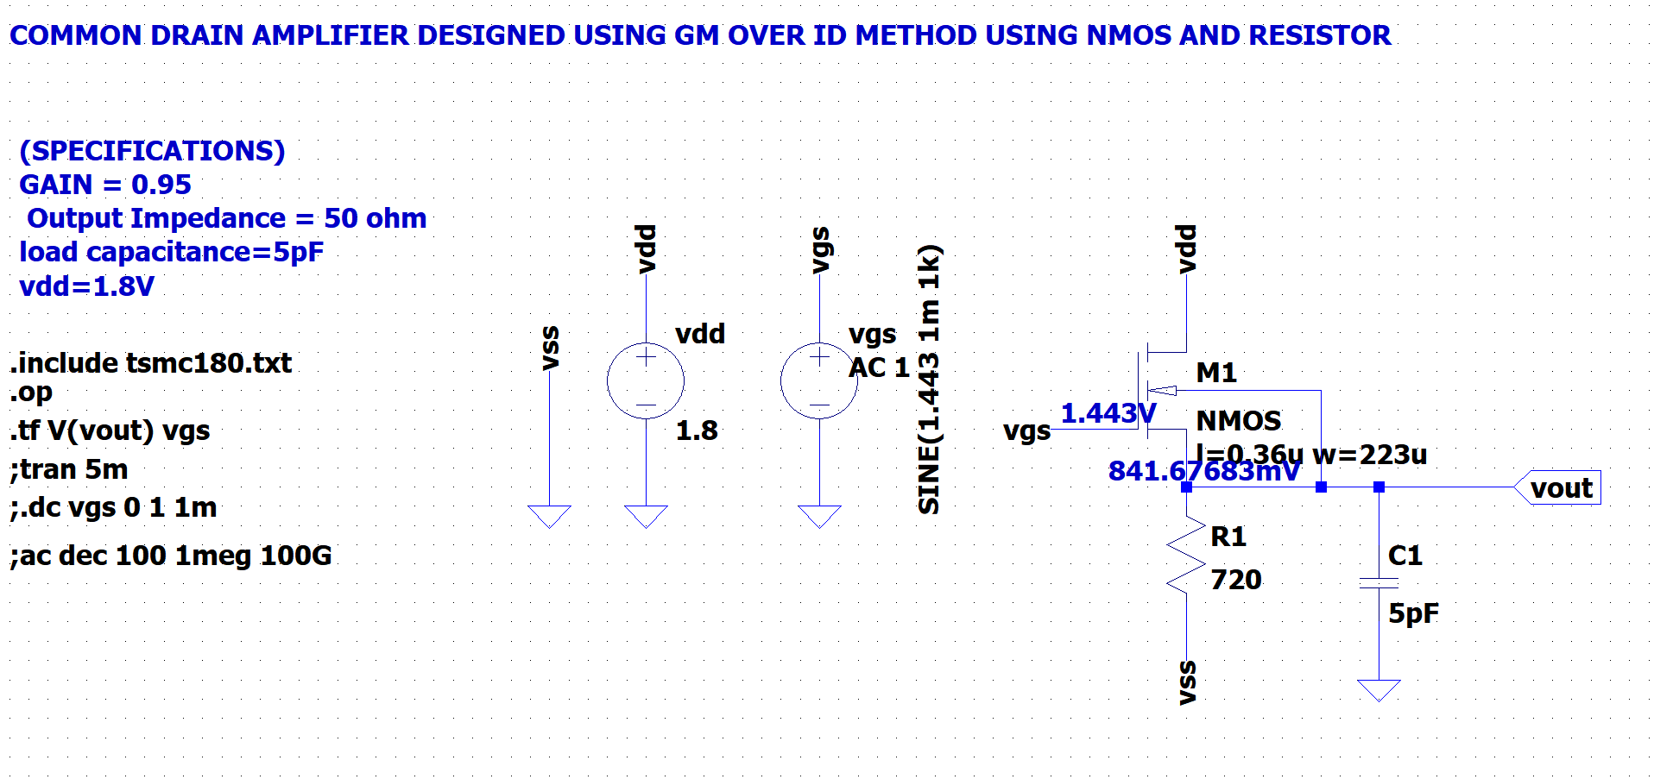
SCHEMATIC IN LT SPICE

Slide 35
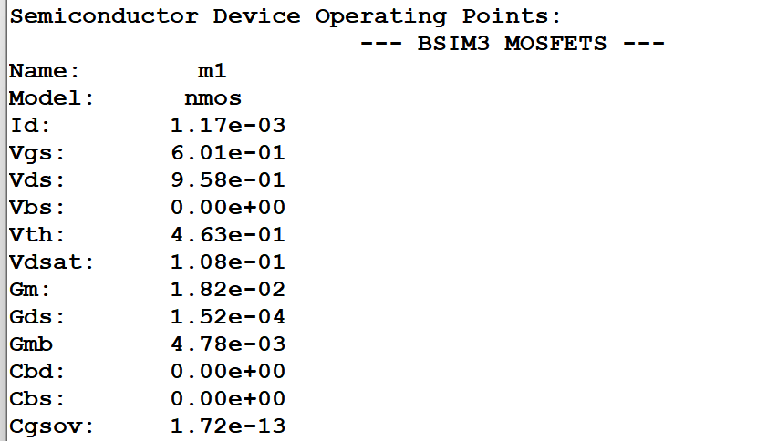
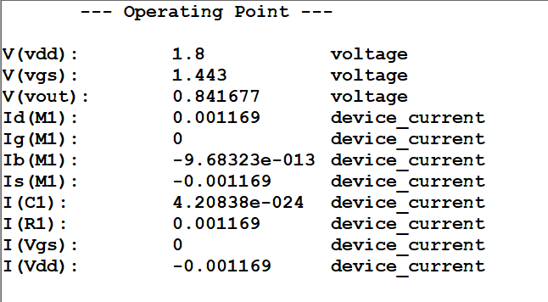
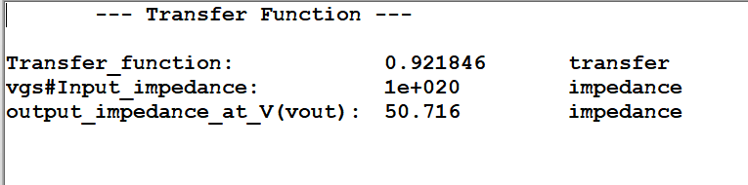

Slide 36
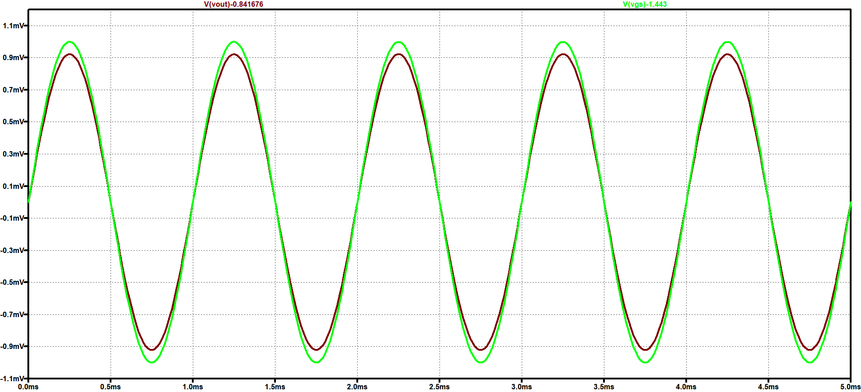
TRANSIENT ANALYSIS IN LT SPICE

Slide 37
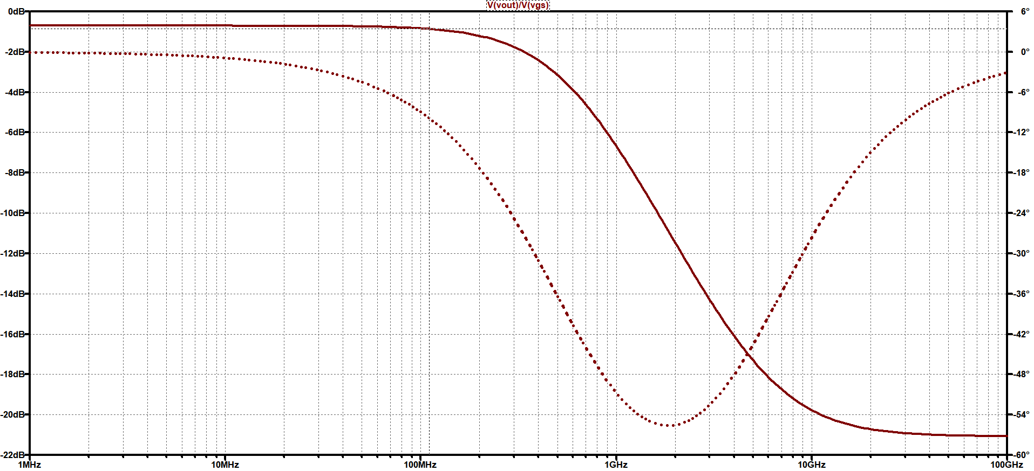
FREQUENCY RESPONSE IN LT SPICE

Slide 38
Feedback I got
Specifications are not exactly matching with simulations , W/L ratio is very high , so now I have to redesign them by making slight modification in design approach

Slide 39
THANK YOU

